Slide 1
Hibernate

Slide 2

Introduction to Hibernate
Basic Mapping
Mapping Relationships
Querying
Advanced Topics
Agenda

Slide 3
Who This Course Is For
Developers that are :
Familiar with Java
At least somewhat comfortable with SQL
Want to learn the Hibernate.

Slide 4
Introductions
Name
Company
Title, function, and job responsibility
Experience related to topics presented in this course
Reasons for enrolling in this course
Expectations for this course

Slide 5
Introduction to Hibernate

Slide 6

Objectives
What is an ORM
What is Hibernate
Hibernate and JPA
Hibernate Architecture
Installing MySQL
Getting Hibernate
Installing Hibernate Tools
Creating The Project
Using The Libraries
Creating The Configuration
Creating The Session Factory
Testing Out The Configuration

Slide 7
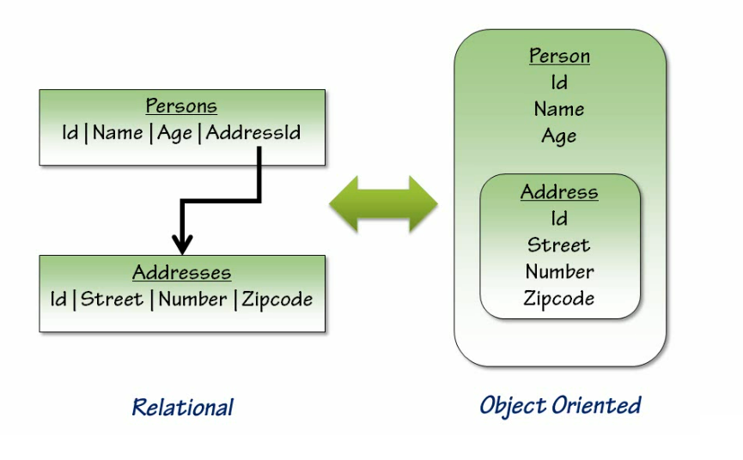
What is an ORM?

Slide 8
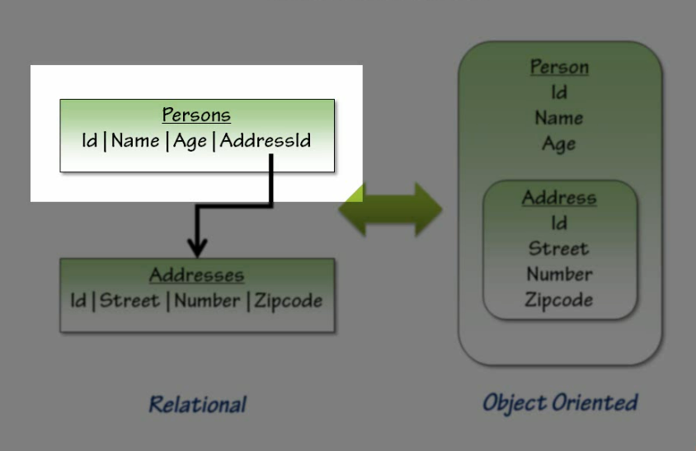
What is an ORM?

Slide 9
What is an ORM?

Slide 10
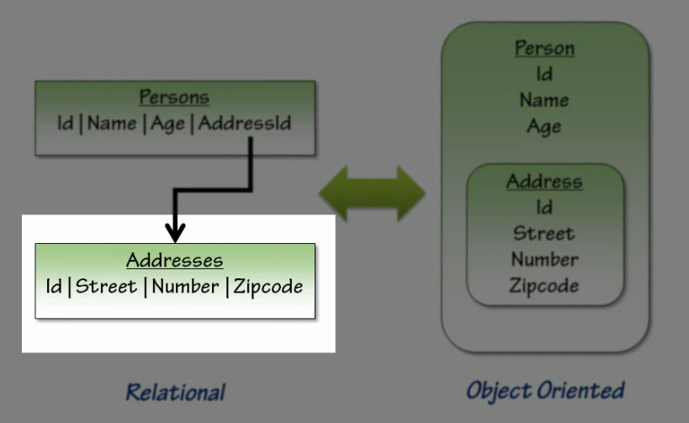
What is an ORM?

Slide 11
What is an ORM?

Slide 12
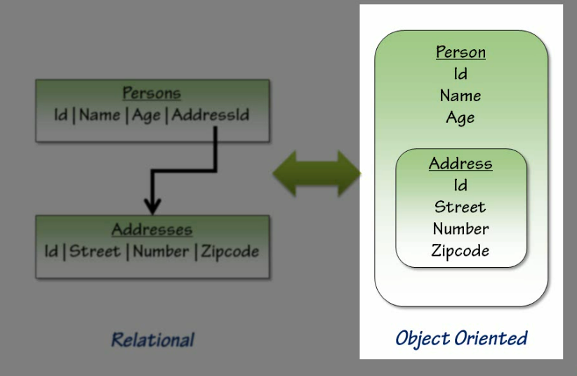
What is ORM ?

Slide 13
What is ORM?

Slide 14
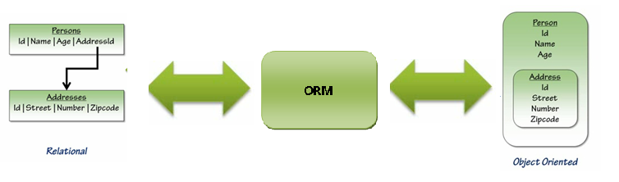
What is ORM ?

Slide 15
What is Hibernate ?
The most popular ORM framework for enabling transparent POJO persistence
Let you work without being constrained by table driven relational database model – handles Object-Relational impedance mismatch
Lets you build persistent objects following common OO programming concepts
Because they are POJOs

Slide 16
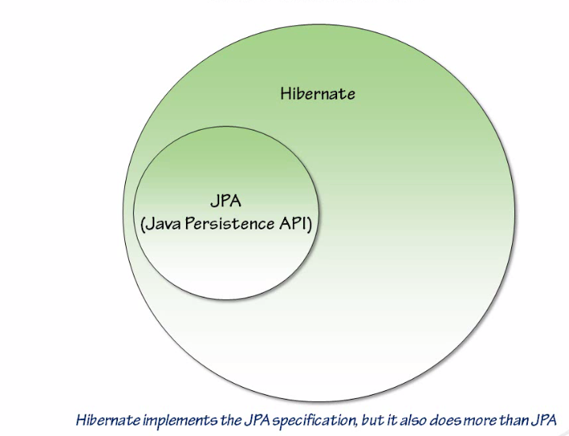
Hibernate and JPA

Slide 17
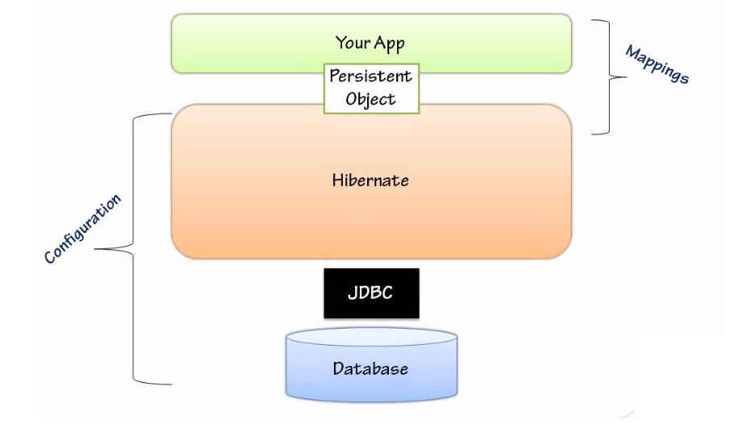
Hibernate Architecture

Slide 18
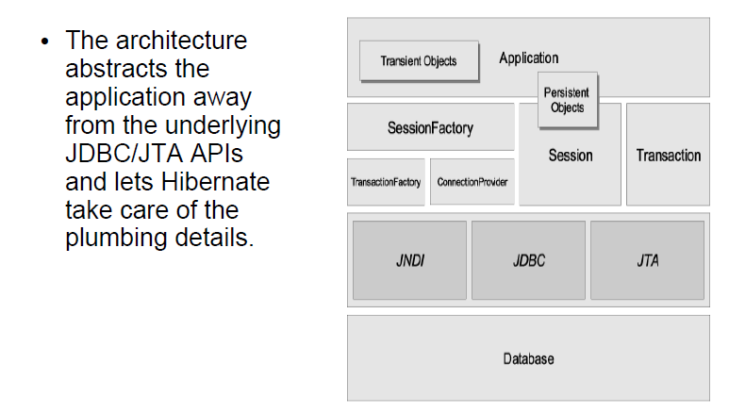
Hibernate Architecture

Slide 19
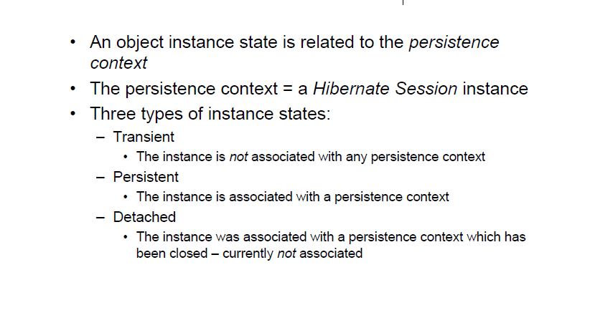
Instance states

Slide 20
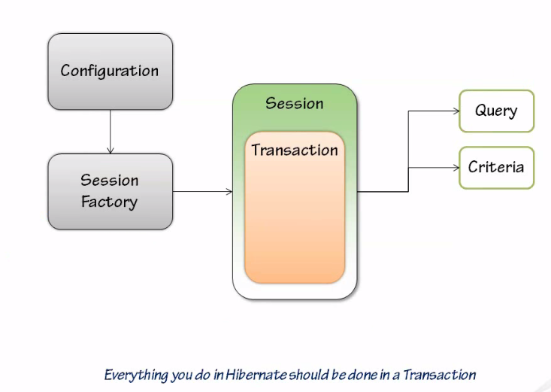
Hibernate Architecture

Slide 21

MySQL Setup
Install MySQL Server.
Configure MySQL
Server Instance.
Install MySQL GUI Tools.

Slide 22
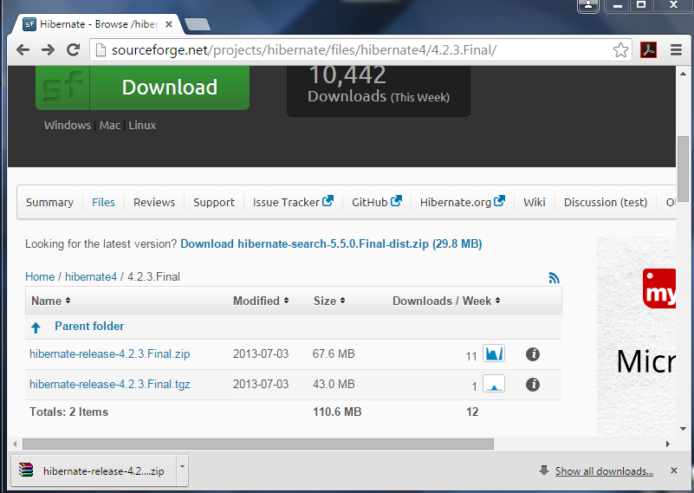
Getting Hibernate
http://sourceforge.net/projects/hibernate/files/hibernate4/4.2.3.Final/

Slide 23
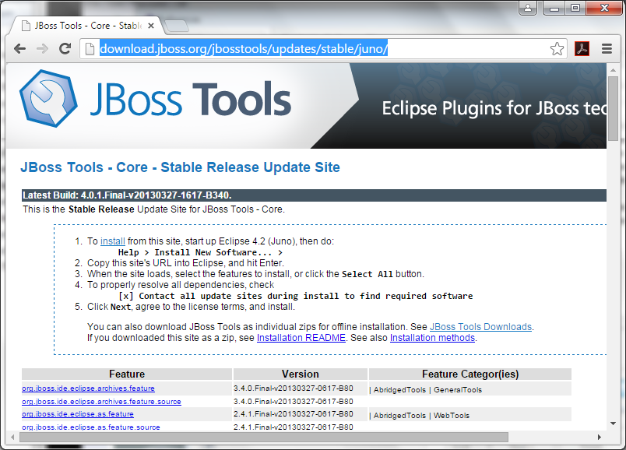
Installing Hibernate Tools
http://download.jboss.org/jbosstools/updates/stable/juno/
Notes:
http://tools.jboss.org/downloads/jbosstools/juno/4.0.1.Final.html#

Slide 24
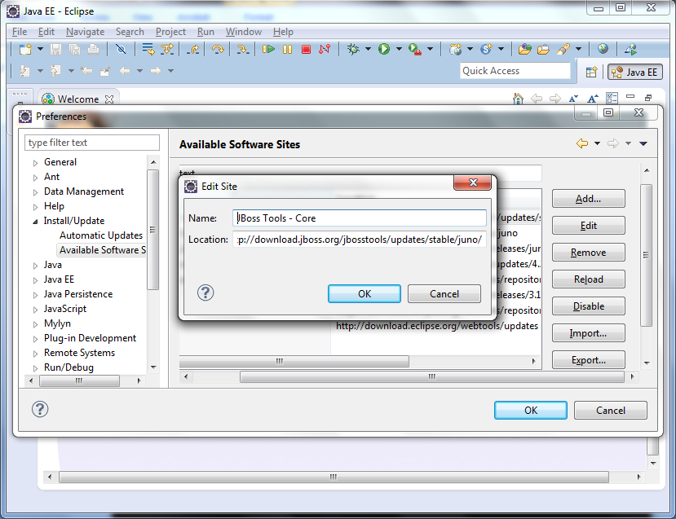
Installing Hibernate Tools

Slide 25
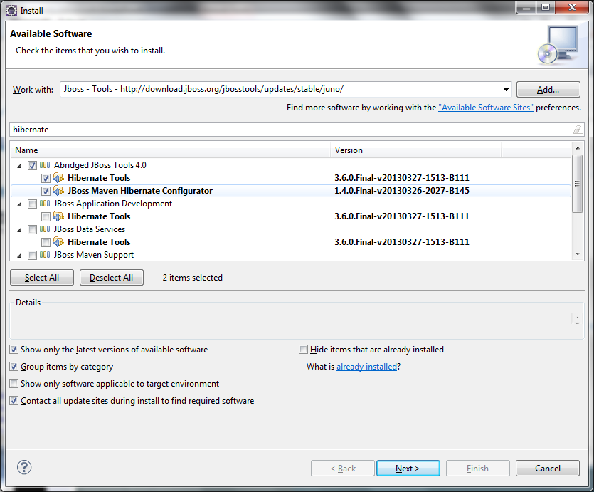
Installing Hibernate Tools

Slide 26
Step by Step Guide
Creating The Project
“ ProteinTracker ”
Creating The Database
“ protein_tracker ”
Database Connections (eclipse)
Using The Libraries
Creating The Configuration
Creating The Session Factory
Testing Out The Configuration

Slide 27
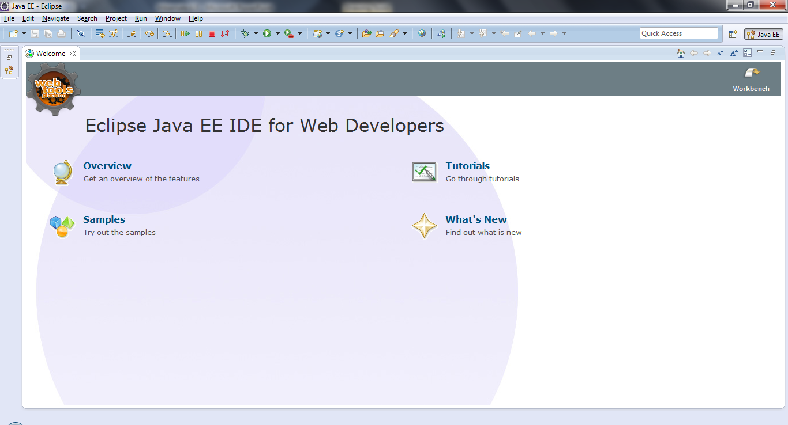
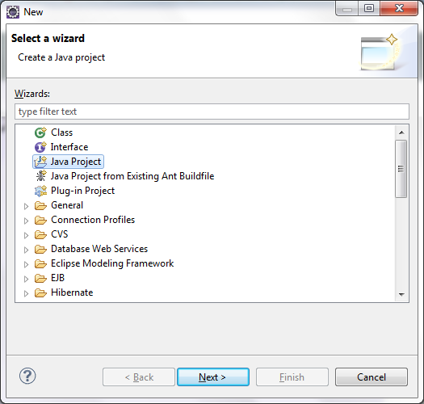
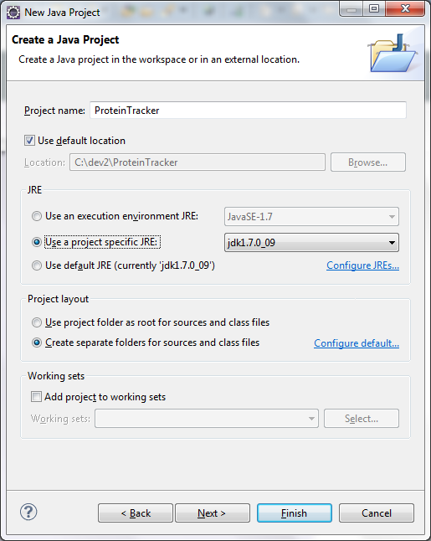
Creating The Project
1
2

Slide 28
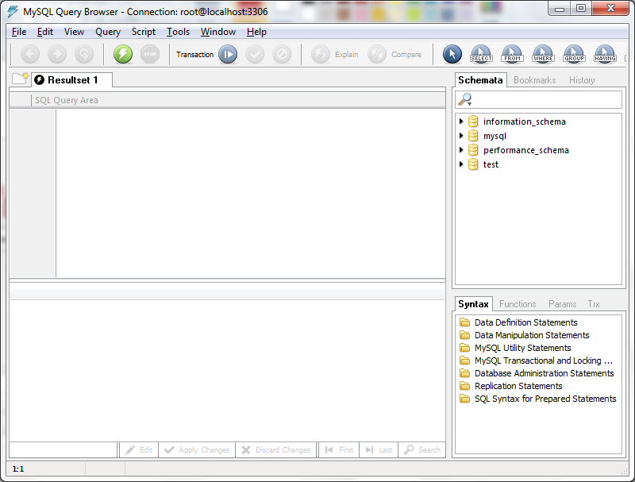
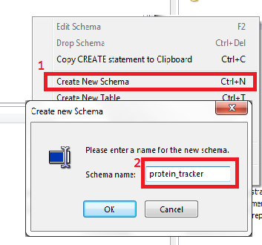
Creating The Database

Slide 29
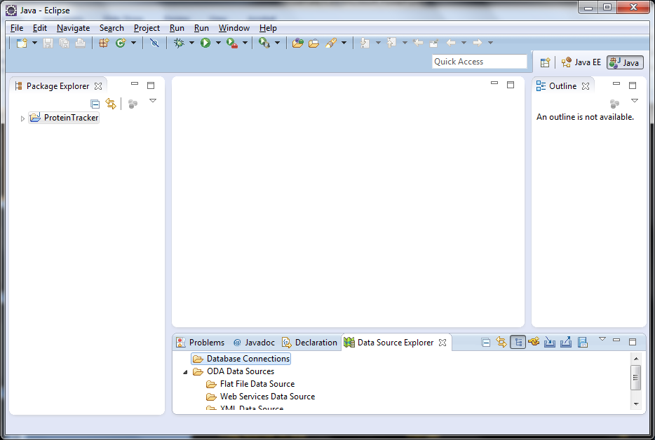
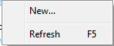
Database Connections (eclipse)
1

Slide 30
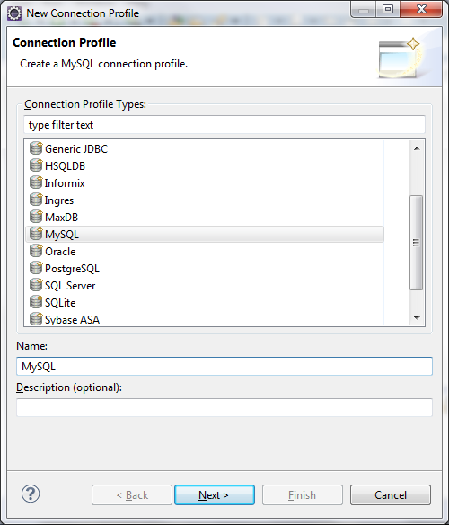
Database Connections (eclipse)
2
1

Slide 31
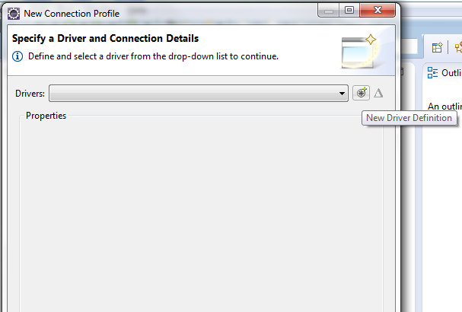
Database Connections (eclipse)
3

Slide 32
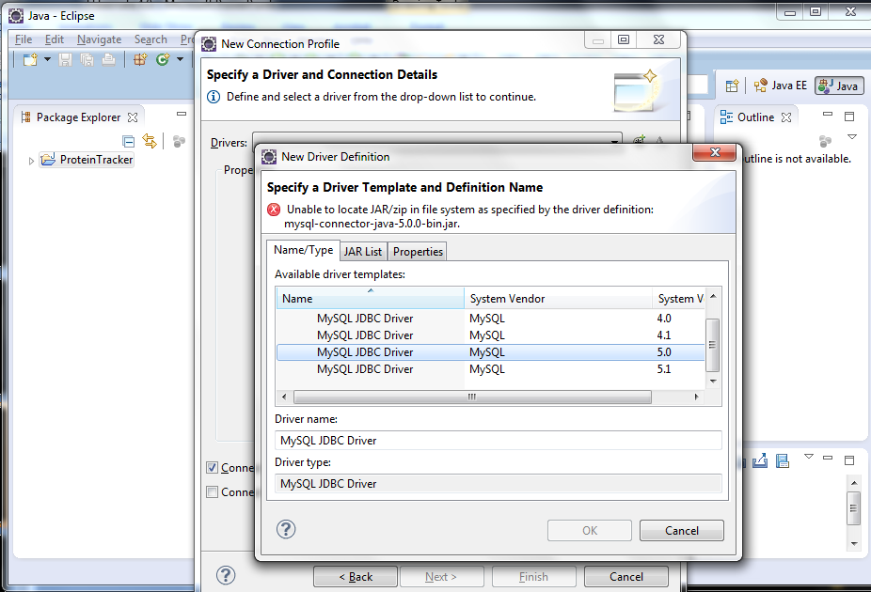
Database Connections (eclipse)
4

Slide 33
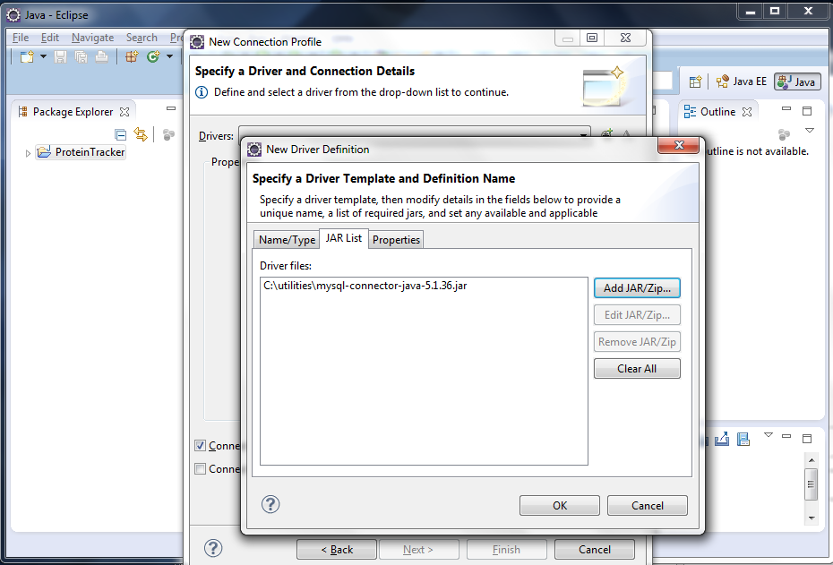
Database Connections (eclipse)
5

Slide 34
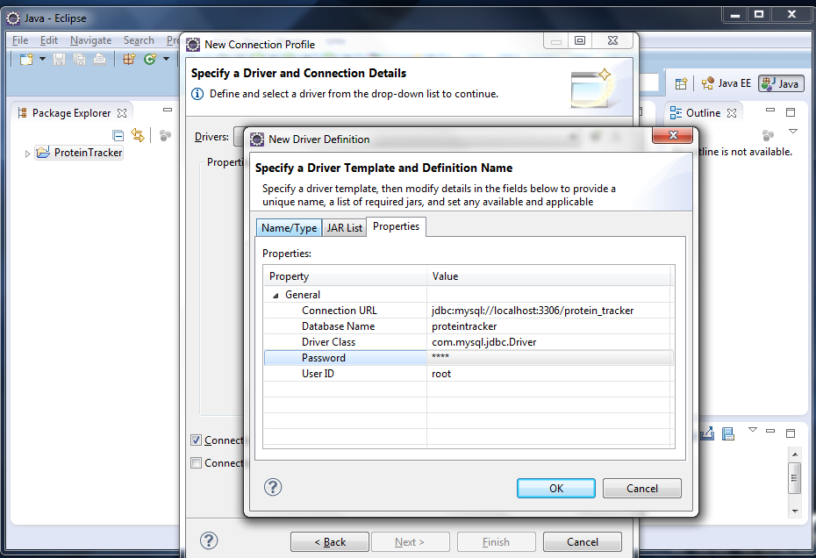
Database Connections (eclipse)
6

Slide 35
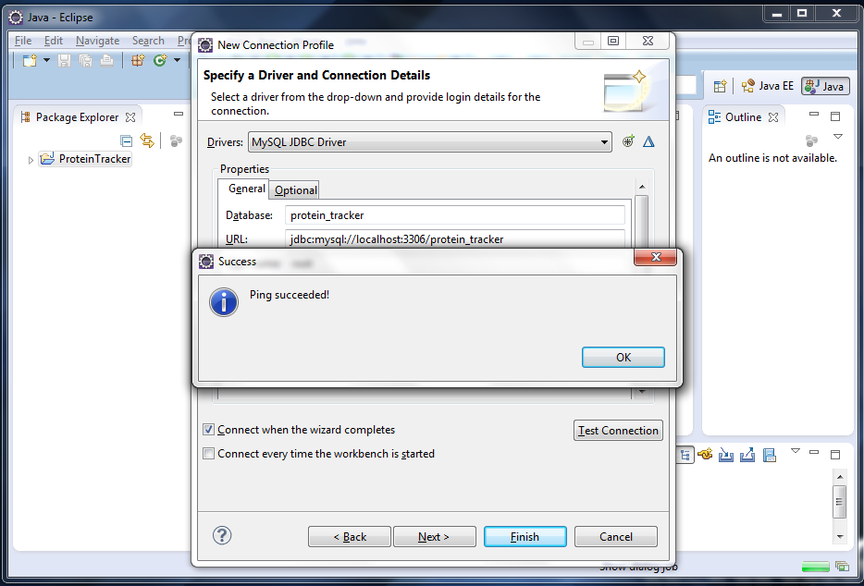
Database Connections (eclipse)

Slide 36
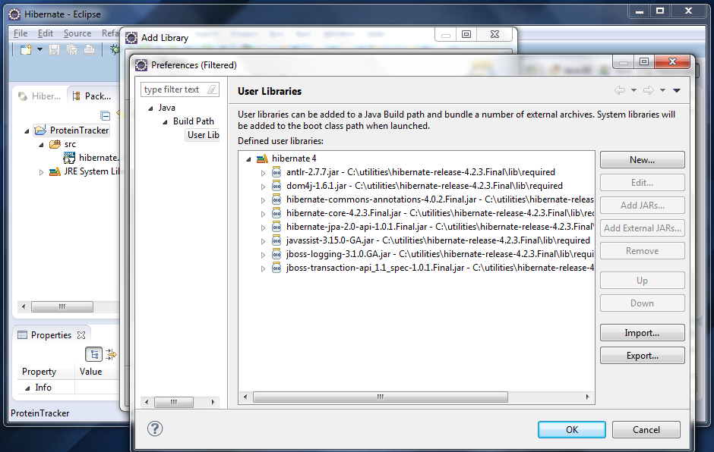
Using The Libraries

Slide 37
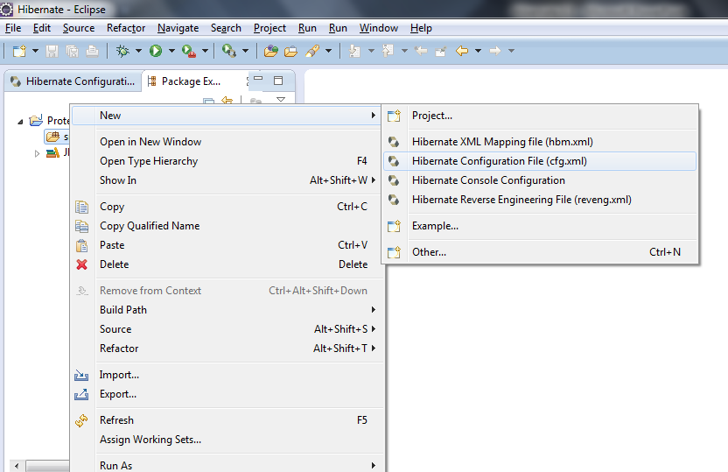
Creating The Configuration

Slide 38
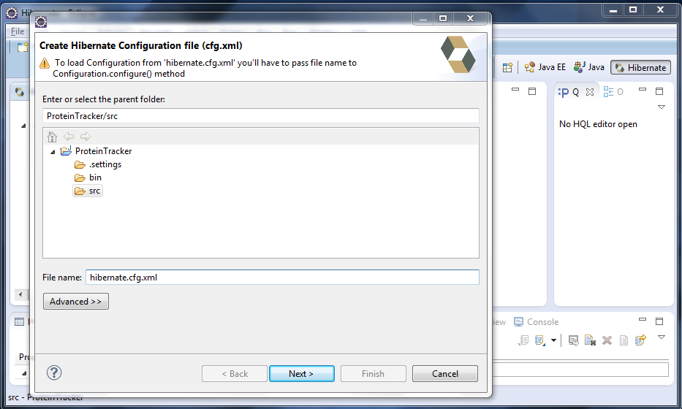
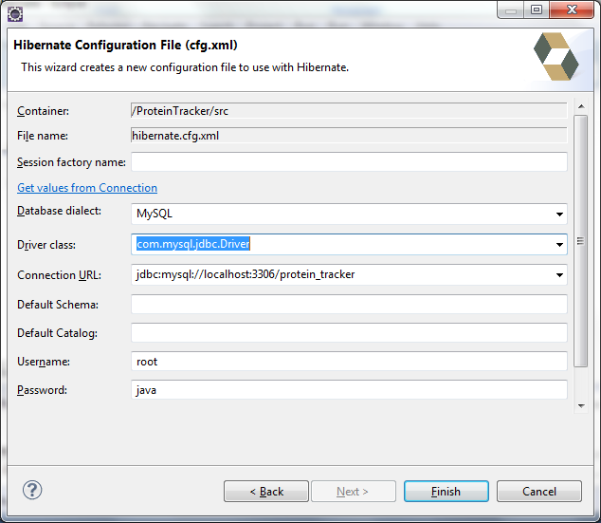
Creating The Configuration

Slide 39
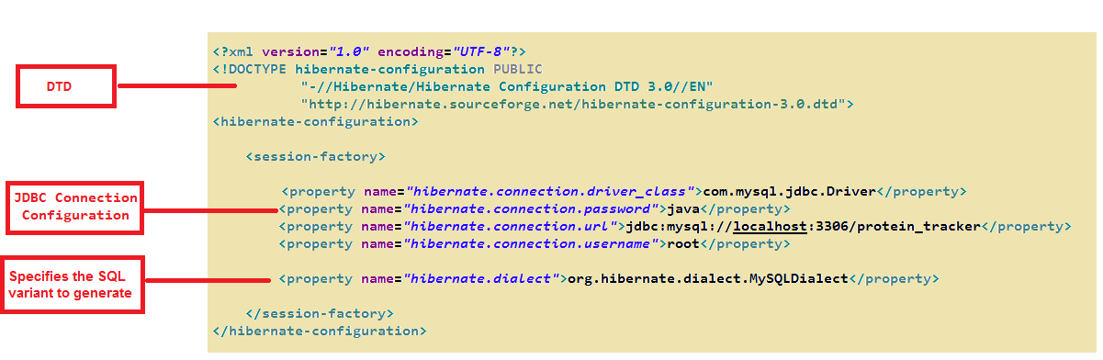
Creating The Configuration

Slide 40
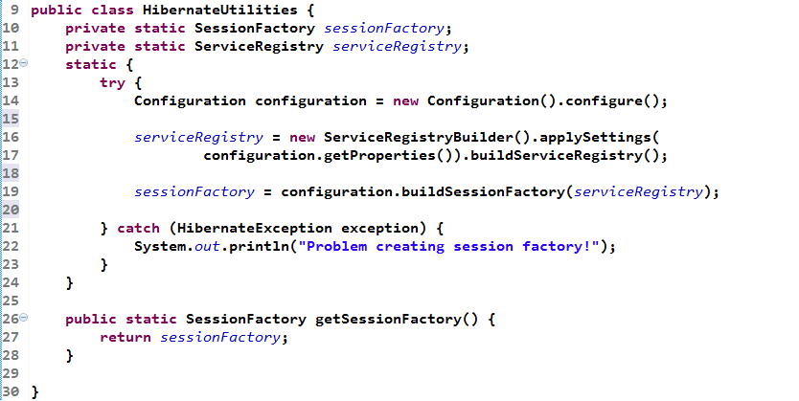
Creating The Session Factory

Slide 41
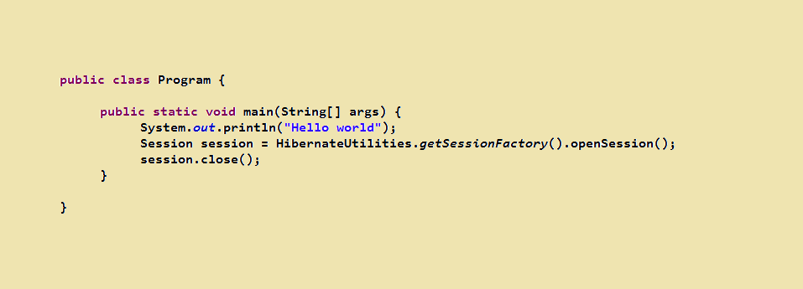

Testing Out The Configuration

Slide 42


Slide 43
Basic Mapping

Slide 44
Objectives
How Mapping Works
Mapping Types
Creating The Java Class
Creating The Table
Creating The Mapping File
Automatic Schema Creation
Using Auto Generation
Getting Data Back
Auto Updating

Slide 45
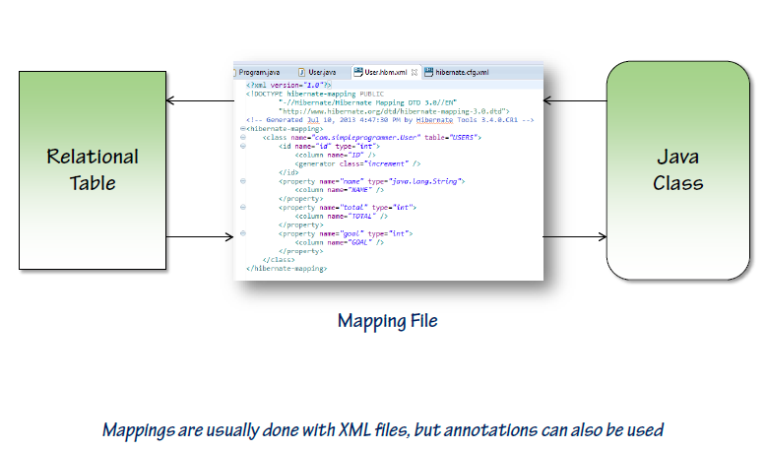
How Mapping Works

Slide 46
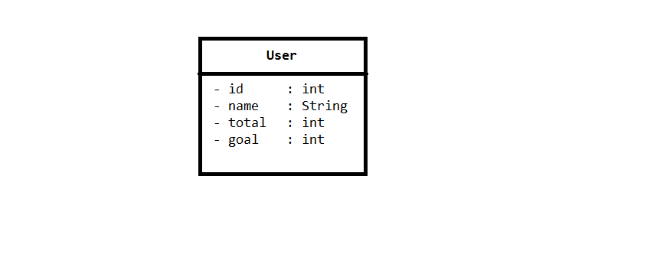
Creating The Java Class

Slide 47
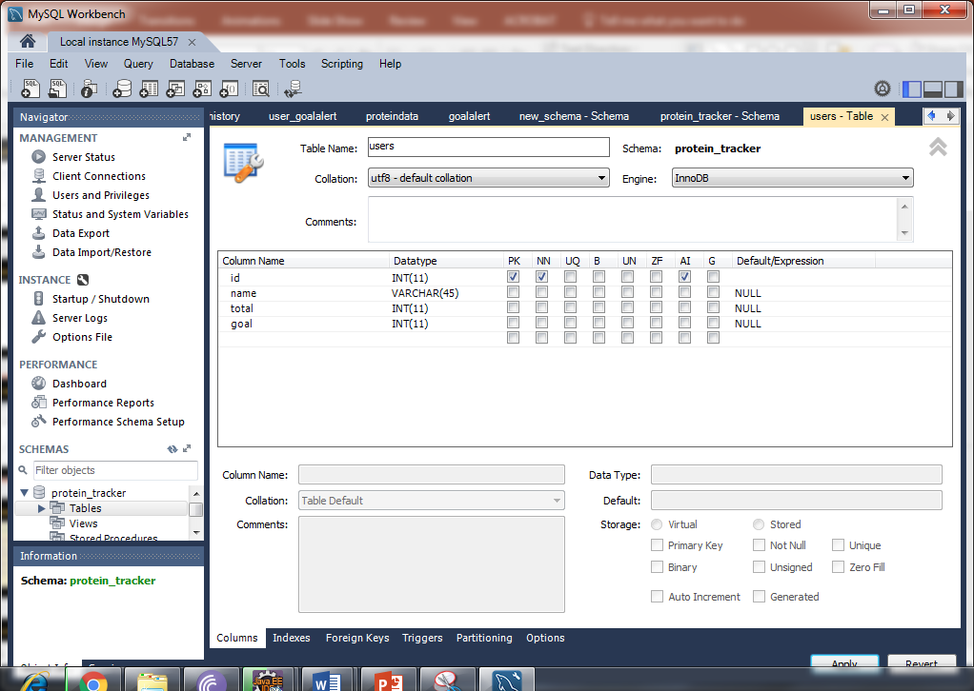
Creating The Table

Slide 48
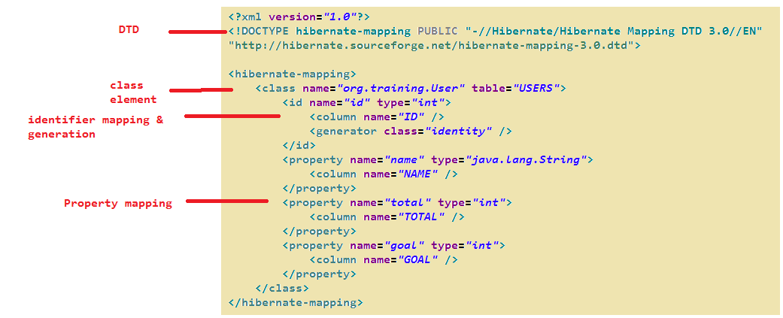
Creating The Mapping File

Slide 49
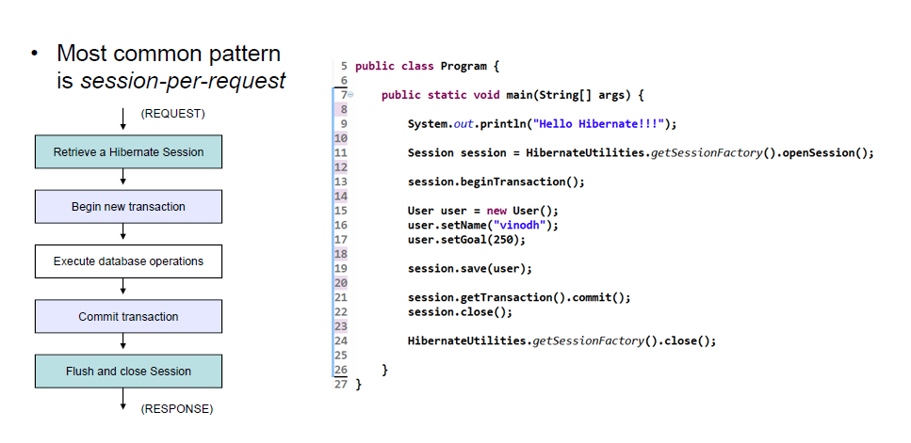
Saving Some Data

Slide 50
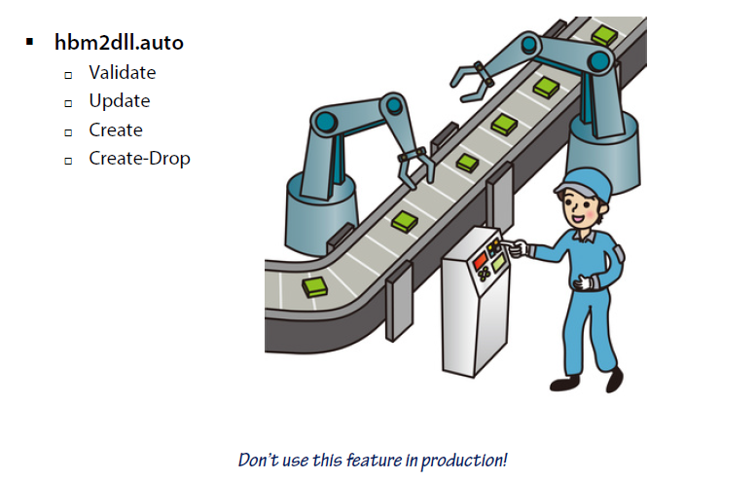
Automatic Schema Creation

Slide 51
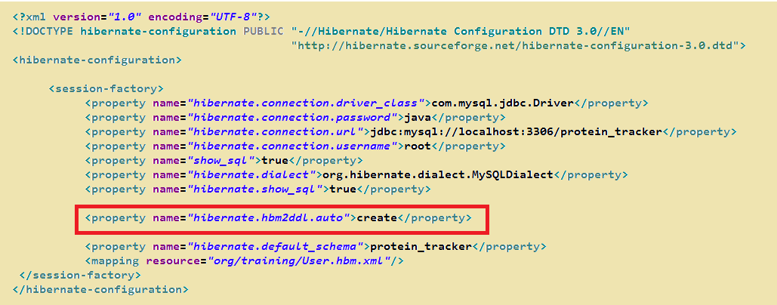
Using Auto Generation

Slide 52
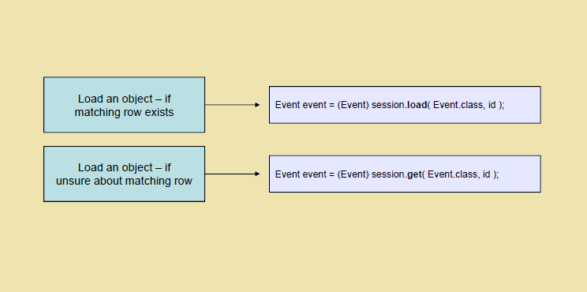
Getting Data Back

Slide 53
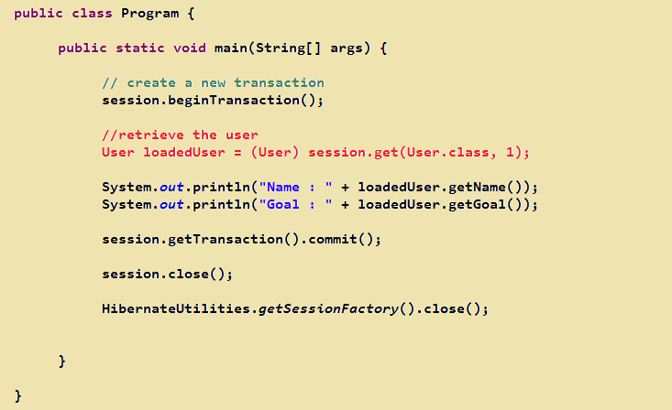
Getting Data Back

Slide 54
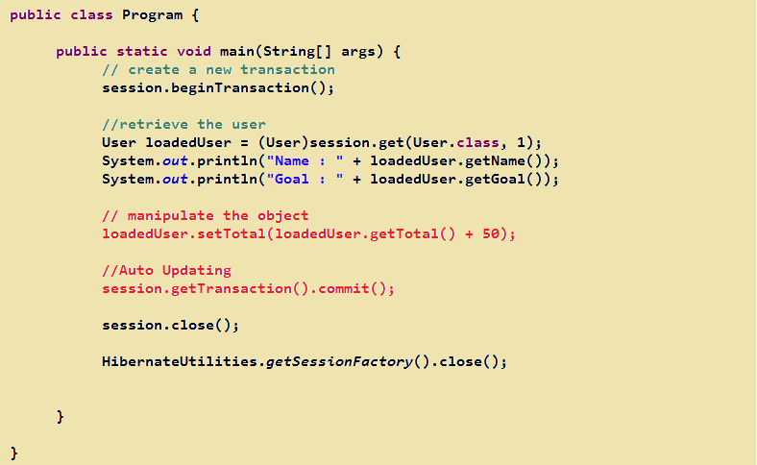
Auto Updating

Slide 56
Mapping Relationships

Slide 57

Mapping Relationships
Value Types Vs Entity Types
Directionality
Components
Creating The Component
Mapping The Component
Value Type Collections
Creating The User History Class
Adding History
Mapping The Set
Mapping A List
Mapping A Map
Mapping A Bag
Agenda

Slide 58
Mapping Relationships
Mapping Entity Type Relationships
One Too Many
Changing Users History To An Entity
Mapping Everything
One To One
Modifying Protein Data
Mapping The One To One
Alternate One To One Mapping
Using A Join Table
Mapping A Join Table
Many To Many
Mapping Many To Many
Agenda

Slide 59
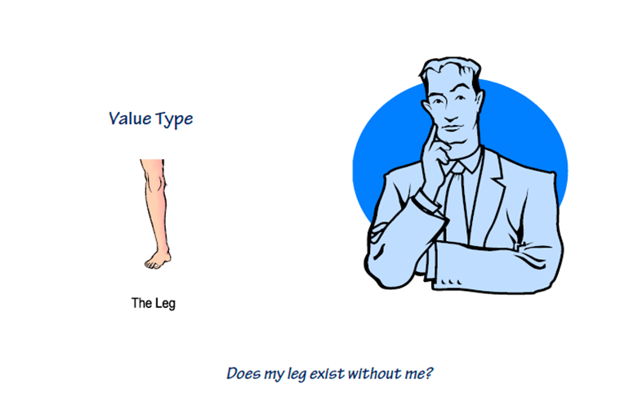
Value Types Vs Entities

Slide 60
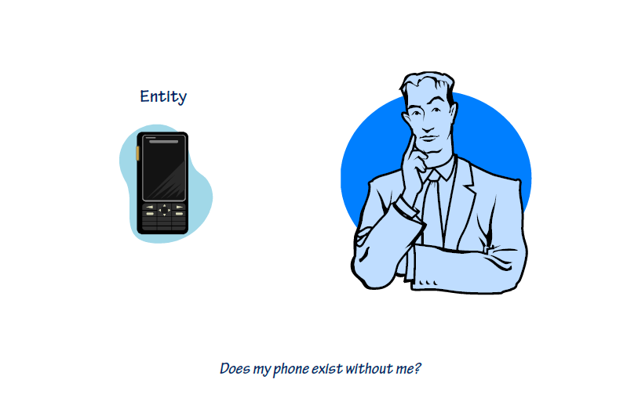
Value Types Vs Entities

Slide 61
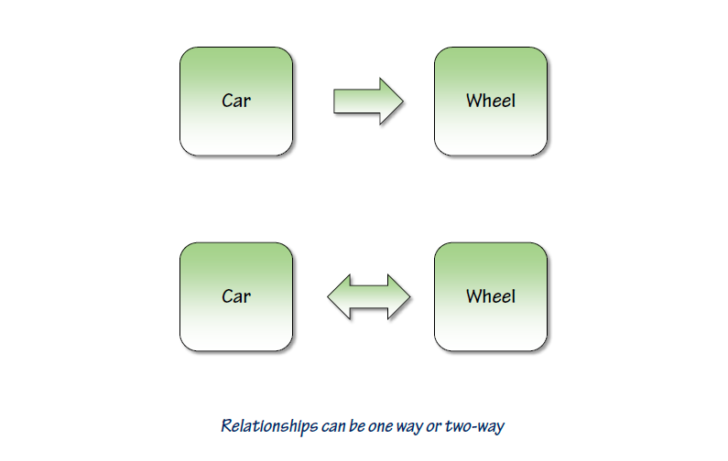
Directionality

Slide 62
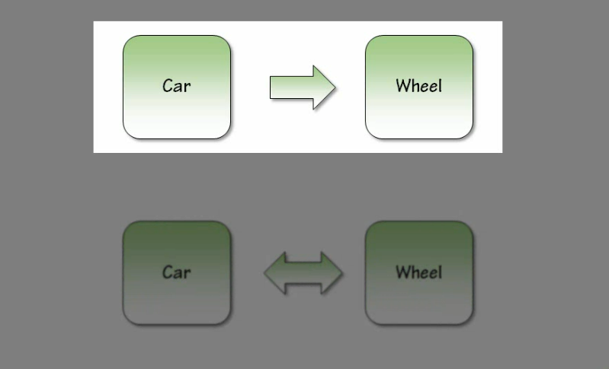
Directionality

Slide 63
Directionality

Slide 64
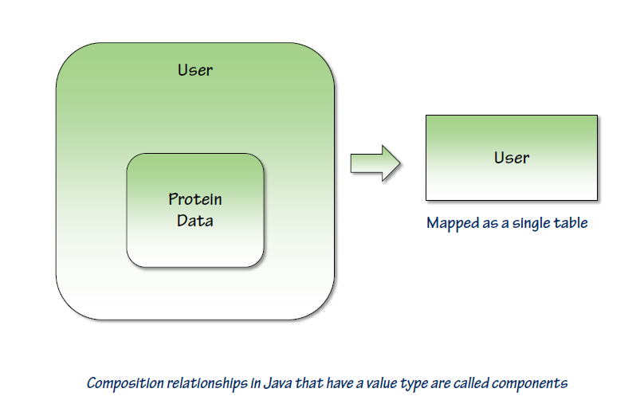
Components

Slide 65
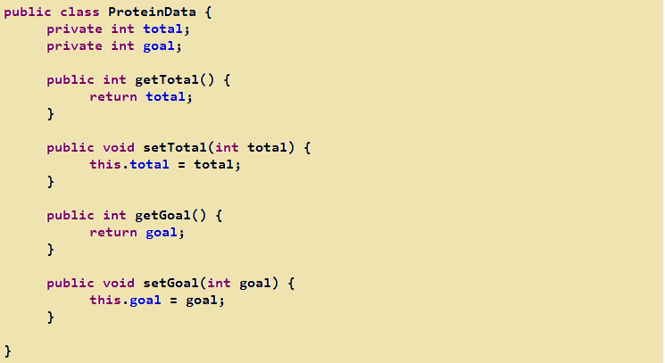
Creating The Component

Slide 66

Creating The Component

Slide 67

Creating The Component

Slide 68

Mapping The Component

Slide 69

Mapping The Component

Slide 70

Value Type Collections

Slide 71

Creating The UserHistory Class

Slide 72

Value Type Using Set Collection

Slide 73

Mapping The Set using <set> element

Slide 74

Adding History to User

Slide 75

Value Type Using List Collection

Slide 76

Mapping The List using <list> element

Slide 77

Value Type Using Map Collection

Slide 78

Value Type Using Map Collection

Slide 79

Mapping a Map Using <map> element

Slide 80

Value Type Using Collection Collection

Slide 81
Modify The Program

Slide 82

Mapping Collection Using <idbag> element

Slide 83

Mapping Entity Relationships

Slide 84

One To Many

Slide 85

Changing Users History To An Entity

Slide 86

Changing Users History To An Entity

Slide 87

Changing Users History To An Entity

Slide 88

Mapping Everything

Slide 89

Mapping Everything
Notes:
Exception in thread "main" org.hibernate.TransientObjectException: object references an unsaved transient instance - save the transient instance before flushing: org.training.UserHistory
Fix this :
<!-- the relationship is bidirectional so update USER_ID only once -->
<list name="history" table="USER_HISTORY" inverse="true" cascade="save-update">
<key column="USER_ID" />
<list-index column="POSITION"/>
<one-to-many class="org.training.UserHistory"/>
</list>

Slide 90

Mapping Everything
Notes:
<!-- the relationship is bidirectional so update USER_ID only once -->
<list name="history" table="USER_HISTORY" inverse="true" cascade="save-update">
<key column="USER_ID" />
<list-index column="POSITION"/>
<one-to-many class="org.training.UserHistory"/>
</list>

Slide 91

One To One

Slide 92

Modifying Protein Data
Notes:
public class ProteinData {
private int id;
private User user;
private int total;
private int goal;
public int getTotal() {
return total;
}
public void setTotal(int total) {
this.total = total;
}
public int getGoal() {
return goal;
}
public void setGoal(int goal) {
this.goal = goal;
}
public int getId() {
return id;
}
public void setId(int id) {
this.id = id;
}
public User getUser() {
return user;
}
public void setUser(User user) {
this.user = user;
}
}

Slide 93

Modify The User
Notes:
public class User {
private int id;
private String name;
private ProteinData proteinData;
public User() {
setProteinData(new ProteinData());
}
private List<UserHistory> history = new ArrayList<>();
public int getId() {
return id;
}
public void setId(int id) {
this.id = id;
}
public String getName() {
return name;
}
public void setName(String name) {
this.name = name;
}
public ProteinData getProteinData() {
return proteinData;
}
public void setProteinData(ProteinData proteinData) {
this.proteinData = proteinData;
proteinData.setUser(this);
}
public List<UserHistory> getHistory() {
return history;
}
public void setHistory(List<UserHistory> history) {
this.history = history;
}
public void addHistory(UserHistory historyItem) {
historyItem.setUser(this);
history.add(historyItem);
}
}

Slide 94

Mapping The One To One
Notes:
<class name="org.training.ProteinData" table="PROTEINDATA">
<id name="id" type="int">
<column name="ID" />
<generator class="foreign" >
<param name="property">user</param>
</generator>
</id>
<one-to-one name="user" class="org.training.User" constrained="true"/>
<property name="total" type="int">
<column name="TOTAL" />
</property>
<property name="goal" type="int">
<column name="GOAL" />
</property>
</class>
---------------------------------------------END-----------------------------
User.hbm.xml
<class name="org.training.User" table="USERS">
<id name="id" type="int">
<column name="ID" />
<generator class="identity" />
</id>
<property name="name" type="java.lang.String">
<column name="NAME" />
</property>
<one-to-one name="proteinData" class="org.training.ProteinData" cascade="save-update" />
<list name="history" table="USER_HISTORY" inverse="true" cascade="save-update">
<key column="USER_ID" />
<list-index column="POSITION" />
<one-to-many class="org.training.UserHistory" />
</list>
</class>

Slide 95

Using A Join Table

Slide 96

Create GoalAlert Class

Slide 97

GoalAlert.hbm.xml
Notes:
<?xml version="1.0"?>
<!DOCTYPE hibernate-mapping PUBLIC "-//Hibernate/Hibernate Mapping DTD 3.0//EN"
"http://hibernate.sourceforge.net/hibernate-mapping-3.0.dtd">
<!-- Generated May 3, 2016 12:52:02 AM by Hibernate Tools 3.4.0.CR1 -->
<hibernate-mapping>
<class name="org.training.GoalAlert" table="GOALALERT">
<id name="id" type="int">
<column name="ID" />
<generator class="increment" />
</id>
<property name="message" type="java.lang.String">
<column name="MESSAGE" />
</property>
</class>
</hibernate-mapping>

Slide 98

User Class
Notes:
package org.training;
import java.util.ArrayList;
import java.util.Collection;
import java.util.HashMap;
import java.util.List;
import java.util.Map;
public class User {
private int id;
private String name;
private ProteinData proteinData ;
public User(){
setProteinData(new ProteinData());
}
private List<UserHistory> history = new ArrayList<>();
private GoalAlert goalAlert;
public int getId() {
return id;
}
public void setId(int id) {
this.id = id;
}
public String getName() {
return name;
}
public void setName(String name) {
this.name = name;
}
public ProteinData getProteinData() {
return proteinData;
}
public void setProteinData(ProteinData proteinData) {
this.proteinData = proteinData;
proteinData.setUser(this);
}
public List<UserHistory> getHistory() {
return history;
}
public void setHistory(List<UserHistory> history) {
this.history = history;
}
public void addHistory(UserHistory historyItem){
historyItem.setUser(this);
history.add(historyItem);
}
public GoalAlert getGoalAlert() {
return goalAlert;
}
public void setGoalAlert(GoalAlert goalAlert) {
this.goalAlert = goalAlert;
}
}

Slide 99

User.hbm.xml
Notes:
<class name="org.training.User" table="USERS">
<id name="id" type="int">
<column name="ID" />
<generator class="identity" />
</id>
<property name="name" type="java.lang.String">
<column name="NAME" />
</property>
<one-to-one name="proteinData" class="org.training.ProteinData" cascade="save-update" />
<list name="history" table="USER_HISTORY" inverse="true" cascade="save-update">
<key column="USER_ID" />
<list-index column="POSITION" />
<one-to-many class="org.training.UserHistory" />
</list>
<join table="USER_GOALALERT" optional="true">
<key column="USER_ID"/>
<many-to-one name="goalAlert"
column="GOALALERT_ID"
not-null="true"
unique="true"
cascade="save-update"/>
</join>
</class>

Slide 100

Program
Notes:
package org.training;
import java.util.Date;
import java.util.Map.Entry;
import org.hibernate.Session;
public class Program {
public static void main(String[] args) {
System.out.println("Hello Hibernate!!!");
Session session = HibernateUtilities.getSessionFactory().openSession();
session.beginTransaction();
User user = new User();
user.setName("vinodh");
user.addHistory(new UserHistory(new Date(), "Set name to vinodh"));
user.getProteinData().setGoal(250);
user.addHistory(new UserHistory(new Date(), "Set the goal to 250"));
user.setGoalAlert(new GoalAlert("Congratulations"));
session.save(user);
session.getTransaction().commit();
session.beginTransaction();
User loadedUser = (User) session.get(User.class, 1);
System.out.println("Name : " + loadedUser.getName());
System.out.println("Goal : " + loadedUser.getProteinData().getGoal());
for (UserHistory history : loadedUser.getHistory()) {
System.out.println(history.getEntryTime().toString() + " "
+ history.getEntry());
}
loadedUser.getProteinData().setTotal(
loadedUser.getProteinData().getTotal() + 50);
loadedUser.addHistory(new UserHistory(new Date(), "Added 50 protein"));
session.getTransaction().commit();
session.close();
HibernateUtilities.getSessionFactory().close();
}
}

Slide 101

Many To Many

Slide 102

Many To Many
Notes:
package org.training;
import java.util.ArrayList;
import java.util.HashSet;
import java.util.List;
import java.util.Set;
public class User {
private int id;
private String name;
// Entity
// one to one
private ProteinData proteinData ;
public User(){
setProteinData(new ProteinData());
}
// value-type using Set collection
// private Set<UserHistory> history = new HashSet<>();
// value-type using List collection
// private List<UserHistory> history = new ArrayList<>();
// value-type using Map collection
// private Map<String,UserHistory> history = new HashMap<>();
// value-type using Collection collection
//private Collection<UserHistory> history = new ArrayList<>();
// Entity Type using List collection
//one user is having many history's
private List<UserHistory> history = new ArrayList<>();
//many to many
private Set<GoalAlert> goalAlerts = new HashSet<GoalAlert>();
public Set<GoalAlert> getGoalAlerts() {
return goalAlerts;
}
public void setGoalAlerts(Set<GoalAlert> goalAlerts) {
this.goalAlerts = goalAlerts;
}
public int getId() {
return id;
}
public void setId(int id) {
this.id = id;
}
public String getName() {
return name;
}
public void setName(String name) {
this.name = name;
}
public ProteinData getProteinData() {
return proteinData;
}
// define a one to one relationship bidirectional
public void setProteinData(ProteinData proteinData) {
this.proteinData = proteinData;
proteinData.setUser(this);
}
public List<UserHistory> getHistory() {
return history;
}
public void setHistory(List<UserHistory> history) {
this.history = history;
}
// provide a functionality to achieve one user is assigned many history's
// bi directional functionality is achived
public void addHistory(UserHistory historyItem){
// one history is assigned to a particular user
historyItem.setUser(this);
//many history's is assigned to particular user
history.add(historyItem);
}
//public GoalAlert getGoalAlert() {
//return goalAlert;
//}
//
//public void setGoalAlert(GoalAlert goalAlert) {
//this.goalAlert = goalAlert;
//}
//public Collection<UserHistory> getHistory() {
//return history;
//}
//
//public void setHistory(Collection<UserHistory> history) {
//this.history = history;
//}
//public Map<String, UserHistory> getHistory() {
//return history;
//}
//
//public void setHistory(Map<String, UserHistory> history) {
//this.history = history;
//}
// public Set<UserHistory> getHistory() {
// return history;
// }
//
// public void setHistory(Set<UserHistory> history) {
// this.history = history;
// }
// public List<UserHistory> getHistory() {
// return history;
// }
//
// public void setHistory(List<UserHistory> history) {
// this.history = history;
// }
}

Slide 103

Many To Many
Notes:
<?xml version="1.0"?>
<!DOCTYPE hibernate-mapping PUBLIC "-//Hibernate/Hibernate Mapping DTD 3.0//EN"
"http://hibernate.sourceforge.net/hibernate-mapping-3.0.dtd">
<!-- Generated Nov 24, 2015 4:28:39 PM by Hibernate Tools 3.4.0.CR1 -->
<hibernate-mapping>
<class name="org.training.User" table="USERS">
<id name="id" type="int">
<column name="ID" />
<generator class="identity" />
</id>
<property name="name" type="java.lang.String">
<column name="NAME" />
</property>
<!-- component mapping -->
<!-- <component name="proteinData">
<property name="total" type="int">
<column name="TOTAL" />
</property>
<property name="goal" type="int">
<column name="GOAL" />
</property>
</component> -->
<!-- value type mapping Set<> collection using <set> element -->
<!-- <set name="history" table="USERS_HISTORY">
Foreign Key Column In USERS_HISTORY
<key column="ID" />
<composite-element class="org.training.UserHistory">
<property name="entryTime" type="date" column="ENTRY_TIME" />
<property name="entry" type="string" column="ENTRY" />
</composite-element>
</set> -->
<!-- value type mapping List<> collection using <list> element -->
<!-- <list name="history" table="USERS_HISTORY">
Foreign Key Column In USERS_HISTORY
<key column="ID" />
<list-index column="POSITION" />
<composite-element class="org.training.UserHistory">
<property name="entryTime" type="date" column="ENTRY_TIME" />
<property name="entry" type="string" column="ENTRY" />
</composite-element>
</list> -->
<!-- value type mapping Map<> collection using <map> element -->
<!-- <map name="history" table="USERS_HISTORY">
Foreign Key Column In USERS_HISTORY
<key column="ID" />
<map-key type="string" column="ENTRY_IDENTIFIER"/>
<composite-element class="org.training.UserHistory">
<property name="entryTime" type="date" column="ENTRY_TIME" />
<property name="entry" type="string" column="ENTRY" />
</composite-element>
</map> -->
<!-- value type mapping Collection<> collection using <idbag> element -->
<!-- <idbag name="history" table="USERS_HISTORY">
<collection-id type="int" column="ID">
<generator class="increment"/>
</collection-id>
Foreign Key Column In USERS_HISTORY
<key column="USER_ID" />
<composite-element class="org.training.UserHistory">
<property name="entryTime" type="date" column="ENTRY_TIME" />
<property name="entry" type="string" column="ENTRY" />
</composite-element>
</idbag> -->
<!-- Entity type mapping List collection using a list element -->
<list name="history" table="USERS_HISTORY" inverse="true" cascade="save-update">
<key column="USER_ID"/>
<list-index column="POSITION"/>
<one-to-many class="org.training.UserHistory"/>
</list>
<one-to-one name="proteinData" class="org.training.ProteinData" cascade="save-update" />
<!-- using the join table -->
<!-- <join table="USER_GOALALERT" optional="true">
<key column="USER_ID"/>
<many-to-one name="goalAlert"
column="GOALALERT_ID"
not-null="true"
unique="true"
cascade="save-update"
/>
</join> -->
<set name="goalAlerts" table="USER_GOALALERT" cascade="save-update">
<key column="USER_ID" />
<many-to-many class="org.training.GoalAlert"
column="GOALALERT_ID" />
</set>
</class>
</hibernate-mapping>

Slide 104

Many To Many
Notes:
public class Program {
public static void main(String[] args) {
System.out.println("Hello Hibernate!!!");
// open a new session
Session session = HibernateUtilities.getSessionFactory().openSession();
//save the data
//begin a transaction
session.beginTransaction();
User user = new User(); // transient state
user.setName("vinodh");
// adding an history to user
user.addHistory(new UserHistory(new Date(), "set the name to vinodh"));
user.getProteinData().setGoal(250);
// adding history to user
user.addHistory(new UserHistory(new Date(), "set the goal to 250"));
user.getGoalAlerts().add(new GoalAlert("Congratulations!"));
user.getGoalAlerts().add(new GoalAlert("You did it!"));
// save only user
session.save(user); // Persistent state
//commit the transaction
session.getTransaction().commit();
// Get the data back
//begin a transaction
session.beginTransaction();
//User loadedUser = (User)session.load(User.class, 2);
User loadedUser = (User)session.get(User.class, 1);
System.out.println("Name : " + loadedUser.getName());
System.out.println("Goal : " + loadedUser.getProteinData().getGoal());
// retrieving the history's from loaded user
// retrieving the history's from loaded user
for (UserHistory history :loadedUser.getHistory()) {
System.out.println(history.getEntryTime().toString() +" "+ history.getEntry());
}
//manipulate the loaded user
loadedUser.getProteinData().setTotal(loadedUser.getProteinData().getTotal() + 50);
user.addHistory(new UserHistory(new Date(), "Added 50 Protein"));
// Auto - Updated
session.getTransaction().commit();
//close the session
session.close();
}
}

Slide 105

Many To Many

Slide 107
Mapping Inheritance

Slide 108
Objectives
One table per each concrete
class implementation
One table for each subclass
One table for each class
hierarchy

Slide 109

One Table per Class Hierarchy

Slide 110

Parent (Book.hbm.xml)

Slide 111

Child (SpecialEditionBook.hbm.xml)

Slide 112

Child (InternationalBook.hbm.xml)

Slide 113

One table per each concrete class implementation

Slide 114

One Table per Subclass

Slide 115

Parent (Book.hbm.xml)

Slide 116

Child (SpecialEditionBook.hbm.xml)

Slide 117

Child (InternationalBook.hbm.xml)

Slide 118

One Table per Subclass

Slide 119

One Table per Concrete Class

Slide 120

One Table per Concrete Class

Slide 121

One Table per Concrete Class

Slide 123
Querying

Slide 124
Objectives
Querying Options
HQL
Creating Some Data
HQL Editor
Select Queries
Where
Using Parameters

Slide 125
Objectives
Paging
Using Named Queries
Implicit Joins
Explicit Joins
Dynamic Instantiation
Criteria
Using The Criteria

Slide 126
Objectives
Running A Criteria Query
Adding Restrictions
Using Projections
Criteria Joins
Query By Example
Using Query By Example

Slide 127

Querying Options

Slide 128

HQL (Hibernate Query Language)

Slide 129

Creating Some Data

Slide 130

Creating Sample Data

Slide 131

Creating Sample Data
Notes:
package org.training;
import java.util.Date;
import java.util.Map.Entry;
import org.hibernate.Session;
public class Program {
public static void main(String[] args) {
System.out.println("Hello Hibernate!!!");
PopulateSampleData();
HibernateUtilities.getSessionFactory().close();
}
private static void PopulateSampleData() {
Session session = HibernateUtilities.getSessionFactory().openSession();
session.beginTransaction();
User vinodh = CreateUser("Vinodh", 500, 50, "Good job", "You made it!");
session.save(vinodh);
User kumar = CreateUser("Kumar", 300, 20, "Taco time!");
session.save(kumar);
User mahendra = CreateUser("Mahendra", 250, 200, "Yes!!!");
session.save(mahendra);
session.getTransaction().commit();
session.close();
}
private static User CreateUser(String name, int goal, int total, String ... alerts){
User user = new User();
user.setName(name);
user.getProteinData().setGoal(goal);
user.addHistory(new UserHistory(new Date(), "Set goal to " + goal));
user.getProteinData().setTotal(total);
user.addHistory(new UserHistory(new Date(), "Set total to " + total));
for(String alert : alerts) {
user.getGoalAlerts().add(new GoalAlert(alert));
}
return user;
}
}

Slide 132

Tables

Slide 133

Tables

Slide 134

HQL Editor

Slide 135

Select Queries

Slide 136

Select Queries

Slide 137

Where

Slide 138

Using Parameters

Slide 139

Using Parameters

Slide 140

Paging
Notes:
package org.training;
import java.util.Date;
import java.util.List;
import org.hibernate.Query;
import org.hibernate.Session;
public class Program {
public static void main(String[] args) {
System.out.println("Hello Hibernate!!!");
PopulateSampleData();
Session session = HibernateUtilities.getSessionFactory().openSession();
session.beginTransaction();
Query query =
session.createQuery("from GoalAlert")
.setFirstResult(2) // start from 3rd row
.setMaxResults(1); // Number of rows
List<GoalAlert> alerts = query.list();
for(GoalAlert alert: alerts){
System.out.println(alert.getMessage());
}
session.getTransaction().commit();
session.close();
HibernateUtilities.getSessionFactory().close();
}
private static void PopulateSampleData() {
Session session = HibernateUtilities.getSessionFactory().openSession();
session.beginTransaction();
User vinodh = CreateUser("Vinodh", 500, 50, "Good job", "You made it!");
session.save(vinodh);
User kumar = CreateUser("Kumar", 300, 20, "Taco time!");
session.save(kumar);
User mahendra = CreateUser("Mahendra", 250, 200, "Yes!!!");
session.save(mahendra);
session.getTransaction().commit();
session.close();
}
private static User CreateUser(String name, int goal, int total, String ... alerts){
User user = new User();
user.setName(name);
user.getProteinData().setGoal(goal);
user.addHistory(new UserHistory(new Date(), "Set goal to " + goal));
user.getProteinData().setTotal(total);
user.addHistory(new UserHistory(new Date(), "Set total to " + total));
for(String alert : alerts) {
user.getGoalAlerts().add(new GoalAlert(alert));
}
return user;
}
}

Slide 141

Using Named Queries

Slide 142

Using Named Queries

Slide 143

Implicit Joins

Slide 144

Explicit Joins

Slide 145

Explicit Joins

Slide 146

Dynamic Instantiation

Slide 147

Dynamic Instantiation

Slide 148
Hibernate Criteria Query
Criteria Query API
The easiest way to retrieve data (from Java developer standpoint)
Pure Java language based

Slide 149

Using The Criteria

Slide 150

Running A Criteria Query

Slide 151

Adding Restrictions

Slide 152

Using Projections
Notes:
session.createCriteria(User.class)
.add(Restrictions.or(
Restrictions.eq("name","Vinodh"),
Restrictions.eq("name","Kumar")
)).setProjection(Projections.projectionList()
.add(Projections.property("name"))
.add(Projections.property("id"))
);

Slide 153

Using Projections

Slide 154

Criteria Joins

Slide 155

Query By Example

Slide 156

Using Query By Example

Slide 158
Hibernate Transaction

Slide 159
Objectives
Session and transaction scopes
Transaction demarcations
JTA-based
JDBC-based
EJB/CMT-based
Interceptor (AOP)-based

Slide 160

Session as a Unit of Work

Slide 161

Session Per Operation

Slide 162

Session Per Request

Slide 163

Session Per Request with Detached Objects

Slide 164

Session Per Conversation

Slide 165

Transaction is always on

Slide 166

Hibernate Application Running Modes

Slide 167

Portability of Applications

Slide 168

Ending a Session

Slide 169

Non-Managed Environment

Slide 170

Managed JTA BMT Environment - Option1

Slide 171

Managed JTA BMT Environment - Option2

Slide 172

Transaction Java Interface

Slide 173

Implementation Classes of ransaction Interface

Slide 174

Types of Transaction Demarcation

Slide 175

JDBC-based Transaction Demarcation

Slide 176

JDBC-based Transaction Demarcation: You manage session

Slide 177

JDBC-based Transaction Demarcation: You manage a session

Slide 178

JDBC-based Transaction Demarcation: Hibernate manages session

Slide 179

JDBC-based Transaction Demarcation: Hibernate manages session

Slide 180

Configuration

Slide 181

What is JTA?

Slide 182

JTA and Hibernate

Slide 183

JTA-based Explicit Transaction Demarcation

Slide 184

Hibernate Configuration

Slide 185

EJB/CMT-based Transaction Demarcation

Slide 186

EJB/CMT-based Transaction Demarcation

Slide 187

Configuration

Slide 188

What is Optimistic Concurrency Control (OCC)?

Slide 189

What Is the Issue of Optimistic Concurrency Control?

Slide 190

Optimistic Locking Configuration

Slide 191
Hibernate Caching

Slide 192

Caching

Slide 193

Configuring Ehcache

Slide 194
Caching Strategies
Read-only
Read/write
Nonstrict read/write
Transactional

Slide 195
Caching Strategy: Read-only
Useful for data that is read frequently but never updated
Simplest and best-performing cache strategy.

Slide 196
Caching Strategy: Read/Write
Appropriate if your data needs to be updated.
They carry more overhead than read-only caches.
In non-JTA environments, each transaction should be completed when Session.close() or Session.disconnect() is called.

Slide 197
Caching Strategy: Nonstrict Cache
Does not guarantee that two transactions won‘t simultaneously modify the same data.
Therefore, it may be most appropriate for data that is read often but only occasionally modified.

Slide 198
Caching Strategy: Transactional
A fully transactional cache that may be used only in a JTA environment

